Slide 1

Environmental Pollution and Remediation: Nuclear Hazards and Solid Waste
Information Security Fundamentals | Environmental Pollution and Remediation
Course: Information Security Fundamentals | Chapter: Environmental Pollution and Remediation | Program: Bachelor of Engineering
DISCOVER · LEARN · EMPOWER
Notes:
Welcome to today's lecture on Environmental Pollution and Remediation. We will focus specifically on the critical topics of nuclear hazards and solid waste management. Understanding these areas is essential for analyzing human impacts on ecosystems. Let us begin by exploring the interconnections between our activities and environmental consequences.

Slide 2
Course Outcomes
SLIDE 2 / 14
Course Outcome
CO | BT LEVEL | DESCRIPTION
CO1 | BT4 | Recall, analyze and respond on fundamental environmental principles, such as ecological relationships and conservation strategies
CO2 | BT4 | Understand and analyze the interconnections between human activities and environmental impacts across different ecosystems
CO3 | BT4 | Understand and analyze and apply environmental laws and policies to analyse and propose solutions for real-world environmental challenges.
CO4 | BT2 | Students will analyse data from environmental monitoring programs to assess trends and predict future impacts on ecosystems.
CO5 | BT6 | Interpret, elaborate and propose various tools, design and innovative strategies for sustainable development and environmental conservation initiatives in securing the planet.
Chandigarh University
2 / 14
Notes:
This lecture directly addresses Course Outcome 2. You will learn to analyze how human activities like nuclear energy use and waste disposal impact various ecosystems. By the end, you will be able to evaluate these interconnections critically. This analysis is the core of our remediation strategies.

Slide 3
Learning Objectives
SLIDE 3 / 14
Learning Outcomes
1
Analyze the sources and biological effects of nuclear radiation hazards.
2
Evaluate the long-term environmental risks of radioactive waste disposal.
3
Apply the 3R concept to reduce solid waste generation effectively.
4
Classify solid waste types and their specific management protocols.
5
Calculate waste reduction metrics using the 3R framework principles.
Chandigarh University
3 / 14
Notes:
By the end of this session, you will be able to analyze nuclear hazards and their biological effects. You will also evaluate the risks of radioactive waste and apply the 3R concept to reduce solid waste. We will classify waste types and calculate reduction metrics. These skills are vital for environmental engineering practice.

Slide 4
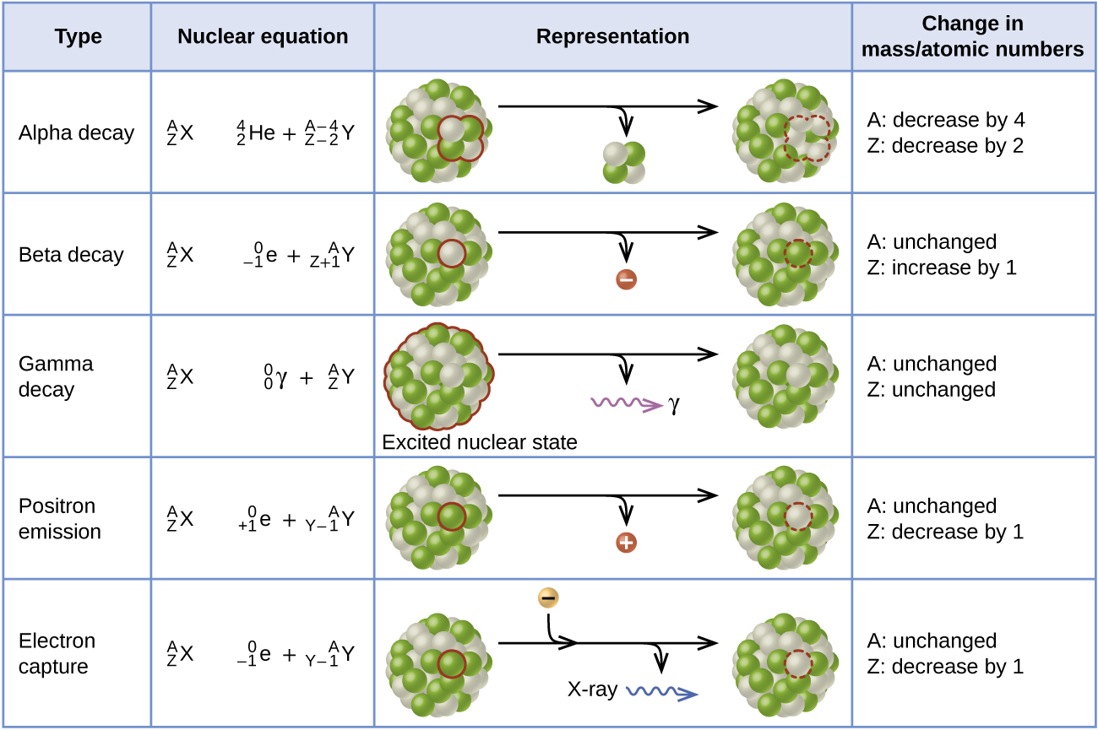
Lecture
SLIDE 4 / 14
Understanding Nuclear Hazards and Sources
1
Nuclear hazards arise from ionizing radiation emitted during radioactive decay processes.
2
Primary sources include nuclear power plants, medical isotopes, and industrial gauges.
3
Accidental releases can contaminate air, water, and soil with long-lived isotopes.
4
α, β, and γ radiation pose distinct biological risks to living tissue.
5
Chernobyl and Fukushima are historical examples of severe nuclear contamination events.
3.1: Nuclear Chemistry and Radioactive Decay - Chemistry LibreTexts
Chandigarh University
4 / 14
Notes:
Nuclear hazards stem from ionizing radiation, which can damage DNA and cause cancer. Primary sources include power plants and medical isotopes used in diagnostics. Accidental releases can contaminate vast areas, as seen in Chernobyl. Understanding the types of radiation is crucial for safety protocols.

Slide 5
Lecture
SLIDE 5 / 14
Biological Effects of Radiation Exposure
1
High radiation doses cause acute radiation syndrome with immediate cellular damage.
2
Low doses increase the long-term risk of genetic mutations and cancer.
3
Thyroid glands are highly sensitive to radioactive iodine-131 contamination.
4
Bone marrow suppression leads to reduced blood cell production in exposed individuals.
5
Cumulative exposure over time significantly elevates the probability of malignancy.
Reduce, Reuse, Recycle: Waste Hierarchy Explained (source: packiro-content-prod.s3.eu-central-1.amazonaws.com)
Chandigarh University
5 / 14
Notes:
Radiation affects the body differently based on dose and duration. High doses cause acute syndrome, while low doses increase cancer risk. The thyroid is particularly vulnerable to iodine-131. Bone marrow suppression is a common consequence of exposure. Cumulative exposure is a major concern for long-term health.

Slide 6
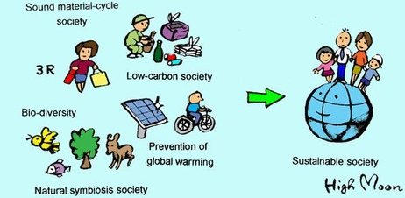
Lecture
SLIDE 6 / 14
Solid Waste Management and Classification
1
Solid waste includes municipal, industrial, agricultural, and biomedical waste streams.
2
Biodegradable waste decomposes naturally but can produce methane if landfilled.
3
Non-biodegradable waste persists for centuries and requires specialized disposal methods.
4
Hazardous waste includes toxic chemicals requiring strict containment and treatment.
5
Electronic waste contains valuable metals but also toxic heavy metals like lead.
The 3R Concept and Waste Minimization (source: www.gdrc.org)
Chandigarh University
6 / 14
Notes:
Solid waste is categorized into municipal, industrial, and hazardous types. Biodegradable waste decomposes but produces methane in landfills. Non-biodegradable waste persists for centuries. Hazardous waste requires strict containment. Electronic waste contains both valuable and toxic materials.

Slide 7
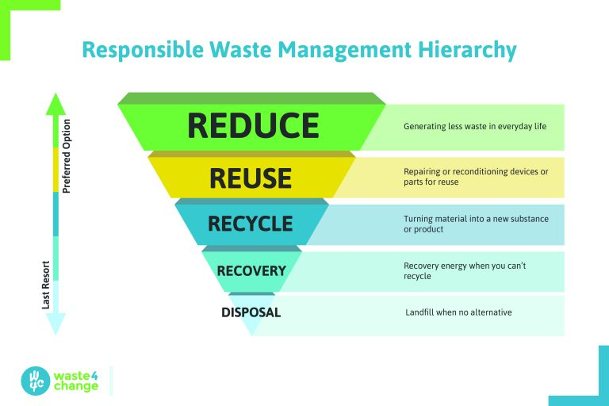
The 3R Concept
SLIDE 7 / 14
Reduce, Reuse, Recycle
1
Reduce minimizes waste generation at the source through better design.
2
Reuse extends the life of products without significant processing or energy.
3
Recycling converts waste materials into new products through industrial processes.
4
The hierarchy prioritizes reduction as the most effective environmental strategy.
5
Implementing 3R reduces landfill dependency and conserves natural resources significantly.
Waste4Change Supports 3R (Reduce-Reuse-Recycle) (source: waste4change.com)
Chandigarh University
7 / 14
Notes:
The 3R concept is the cornerstone of sustainable waste management. Reduce minimizes waste at the source, which is the most effective strategy. Reuse extends product life without processing. Recycling converts waste into new products. This hierarchy prioritizes reduction to conserve resources.

Slide 8
Lecture
SLIDE 8 / 14
Nuclear Waste Disposal Strategies
1
Low-level waste is often compacted and buried in shallow landfills.
2
High-level waste requires deep geological repositories for long-term isolation.
3
Vitrification immobilizes radioactive isotopes in a stable glass matrix.
4
Storage pools cool spent fuel rods before permanent disposal is arranged.
5
International treaties regulate the transboundary movement of nuclear waste materials.
Reduce, Reuse, Recycle: Waste Hierarchy Explained (source: packiro-content-prod.s3.eu-central-1.amazonaws.com)
Chandigarh University
8 / 14
Notes:
Nuclear waste disposal depends on the radioactivity level. Low-level waste goes to shallow landfills. High-level waste needs deep geological repositories. Vitrification immobilizes isotopes in glass. Storage pools cool fuel rods before permanent disposal.

Slide 9
Worked Example
SLIDE 9 / 14
Waste Reduction Calculation
GOVERNING EQUATION
New waste amount = 500 kg × (1 - 0.40) = 300 kg per month
1
A factory generates 500 kg of plastic waste monthly before reduction.
2
Implementing 3R reduces waste by 40% through source reduction and reuse.
3
Annual reduction = (500 - 300) kg × 12 months = 2400 kg saved.
4
This reduction saves 1200 liters of water used in plastic production.
The 3R Concept and Waste Minimization (source: www.gdrc.org)
Chandigarh University
9 / 14
Notes:
Let's calculate the impact of 3R. A factory generates 500 kg of plastic monthly. A 40% reduction means new waste is 300 kg. The annual saving is 2400 kg. This also saves 1200 liters of water. This demonstrates the tangible benefits of the 3R concept.

Slide 10
Lecture
SLIDE 10 / 14
Common Pitfalls in Waste Management
1
Contaminated recyclables often render entire batches unsuitable for processing.
2
Over-reliance on recycling ignores the higher priority of waste reduction.
3
Improper segregation leads to hazardous materials entering general waste streams.
4
Lack of public awareness results in low participation in recycling programs.
5
Ignoring the lifecycle of products leads to premature disposal and waste.
Reduce, Reuse, Recycle: Waste Hierarchy Explained (source: packiro-content-prod.s3.eu-central-1.amazonaws.com)
Chandigarh University
10 / 14
Notes:
Common pitfalls include contaminated recyclables which ruin batches. Over-reliance on recycling ignores the need for reduction. Improper segregation mixes hazardous materials with general waste. Lack of awareness leads to low participation. Ignoring product lifecycles causes premature disposal.

Slide 11
Lecture
SLIDE 11 / 14
Remediation Techniques for Contaminated Sites
1
Phytoremediation uses plants to absorb and stabilize soil contaminants.
2
Bioremediation employs microorganisms to degrade organic pollutants in soil.
3
Excavation removes contaminated soil for treatment or secure landfilling.
4
Chemical oxidation breaks down hazardous compounds into less toxic forms.
5
Natural attenuation relies on time and natural processes to reduce risk.
Chandigarh University
11 / 14
Notes:
Remediation techniques restore contaminated sites. Phytoremediation uses plants to absorb contaminants. Bioremediation uses microbes to degrade pollutants. Excavation removes soil for treatment. Chemical oxidation breaks down hazardous compounds. Natural attenuation relies on time.

Slide 12

Lecture
SLIDE 12 / 14
Regulatory Frameworks and Compliance
1
National laws mandate strict handling and disposal of nuclear waste.
2
International conventions like Basel regulate transboundary movement of hazardous waste.
3
Compliance requires regular monitoring of air, water, and soil quality.
4
Penalties for non-compliance include heavy fines and operational shutdowns.
5
Certification ensures waste management facilities meet safety and environmental standards.
Source: waste-management-world.com
Chandigarh University
12 / 14
Notes:
Regulatory frameworks ensure safety. National laws mandate strict handling of nuclear waste. International conventions like Basel regulate waste movement. Compliance requires regular monitoring. Penalties for non-compliance are severe. Certification ensures facilities meet standards.

Slide 13
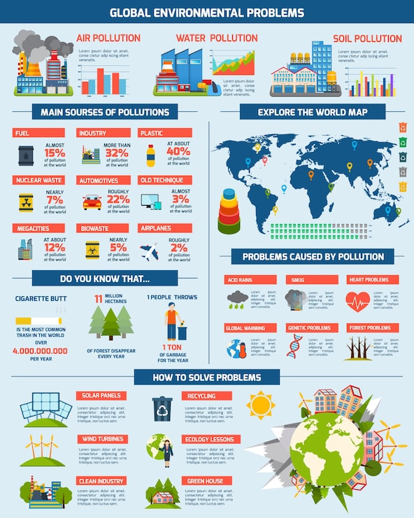
Lecture
SLIDE 13 / 14
Key Takeaways
1
Nuclear hazards pose severe risks requiring strict containment and monitoring.
2
The 3R hierarchy prioritizes reduction to minimize waste generation effectively.
3
Solid waste classification determines the appropriate management and disposal method.
4
Remediation techniques restore contaminated environments through biological or chemical means.
5
Regulatory compliance is essential for safe and sustainable environmental practices.
Source: img.magnific.com
Chandigarh University
13 / 14
Notes:
Key takeaways include the severity of nuclear hazards and the need for containment. The 3R hierarchy prioritizes reduction. Classification determines disposal methods. Remediation restores environments. Regulatory compliance is essential for safety. These points are critical for your understanding.

Slide 14
Lecture
SLIDE 14 / 14
References
ENVIRONMENTAL STUDIES
From Crisis to Cure — R. Rajagopalan
• Environmental Science and Engineering — Benny Joseph
• Environmental Studies — R.C. Sharma and D. Gurbir Sangha
• Introduction to Environmental Science — Anjaneyulu, Y.
• Environmental Pollution Control Engineering — C.S. Rao
• Textbook of Environmental Studies for undergraduate courses — E. Bharucha
• Environmental Science — S.C. Santra
Chandigarh University
14 / 14
Notes:
These references provide in-depth knowledge on environmental science and engineering. They cover nuclear hazards, waste management, and remediation techniques. Please consult these texts for further study and detailed case studies. They are essential resources for your academic and professional growth.

